Slide 1
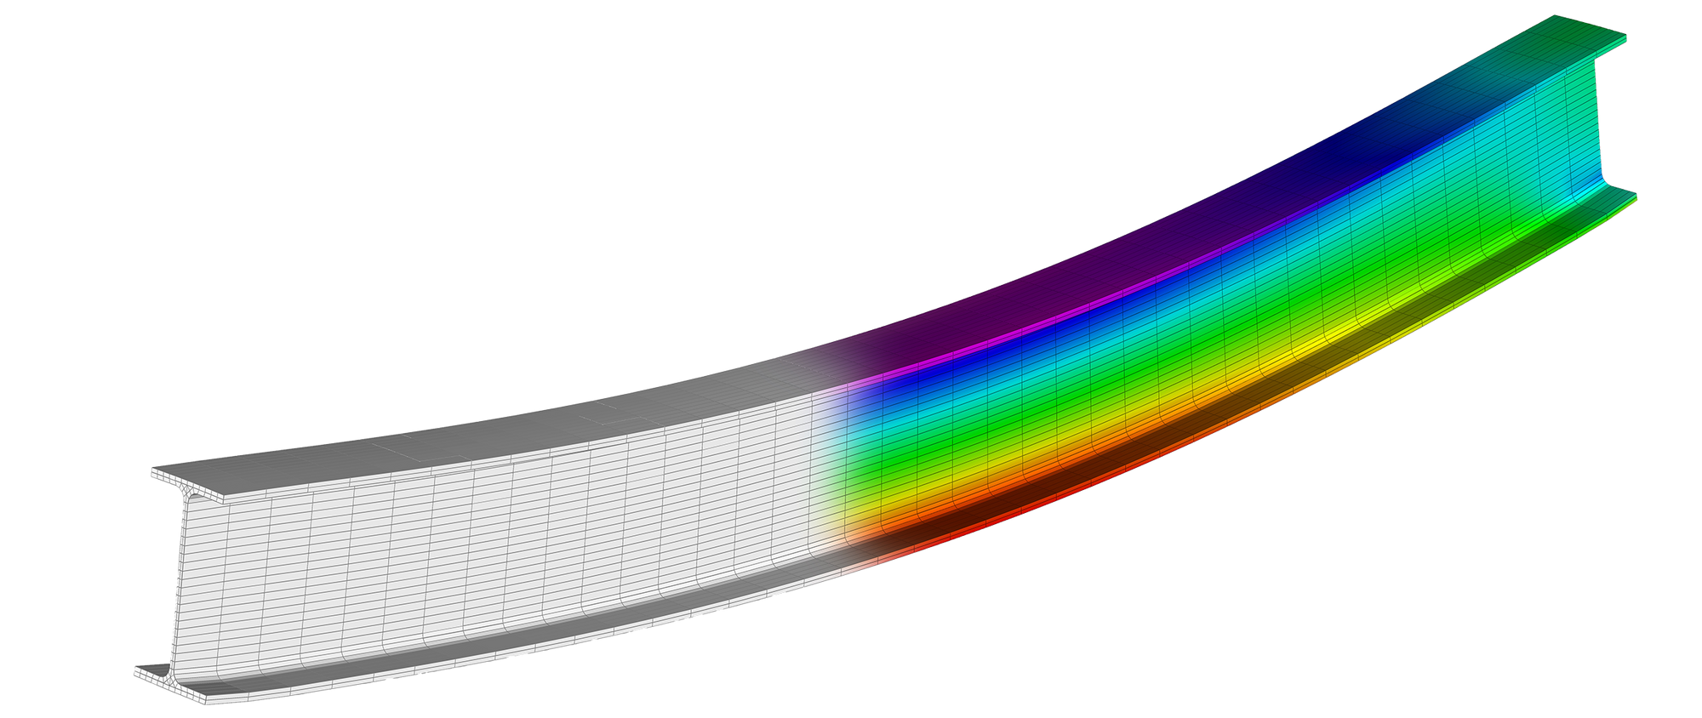
FEM OVERVIEW
Kyler & Trevor
FEM Formation – Basic FEM Examples – EIT Application – 3D EIT FEM – Optimization
12/6/2024

Slide 2
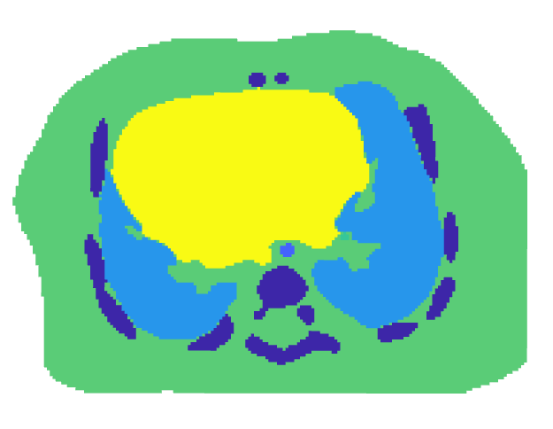
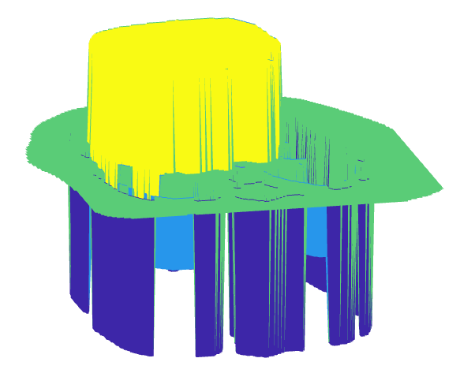
Why FEM?
FEM Formation – Basic FEM Examples – EIT Application – 3D EIT FEM – Optimization
12/6/2024
Notes:
Complex geometries
Different materials
Localized refinement
Error minimization
Nonlinear problems

Slide 3
FEM Steps
FEM Formation – Basic FEM Examples – EIT Application – 3D EIT FEM – Optimization
12/6/2024
Discretize the Domain
1
2
Build Element Equations
Assemble Global System
3
4
Impose the BCs
Solve Reduced System
5
6
Solve Secondary Unknowns

Slide 4
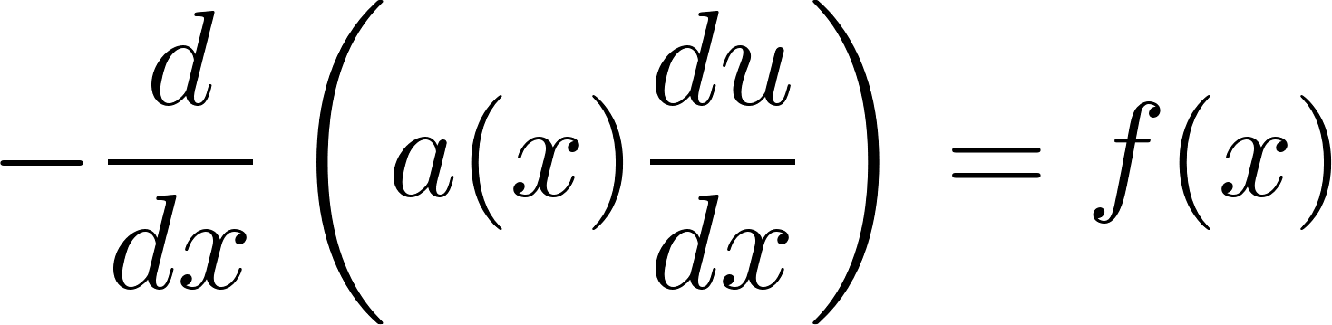
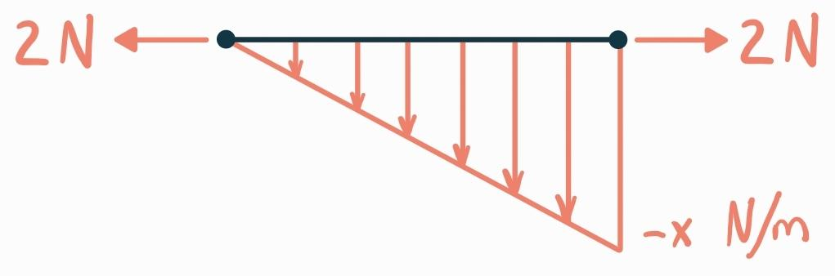
1D FEM Setup
FEM Formation – Basic FEM Examples – EIT Application – 3D EIT FEM – Optimization
12/6/2024

Slide 5
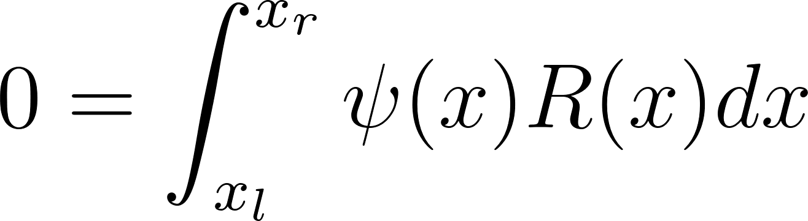
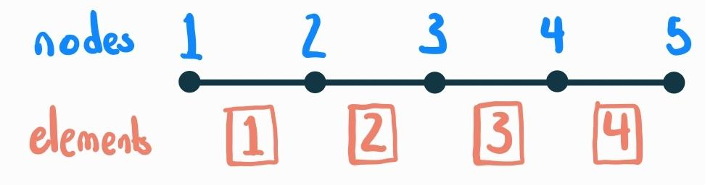
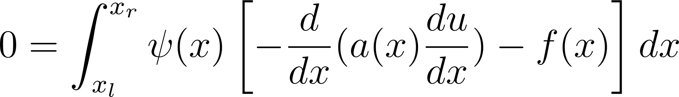
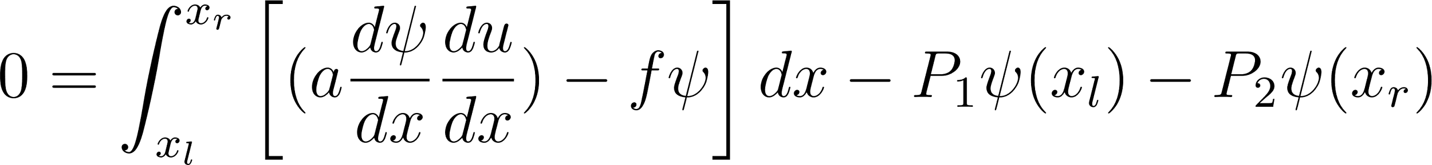
1D FEM Element Equations
FEM Formation – Basic FEM Examples – EIT Application – 3D EIT FEM – Optimization
12/6/2024
Galerkin (Weighted Residual) Method
2
1

Slide 6
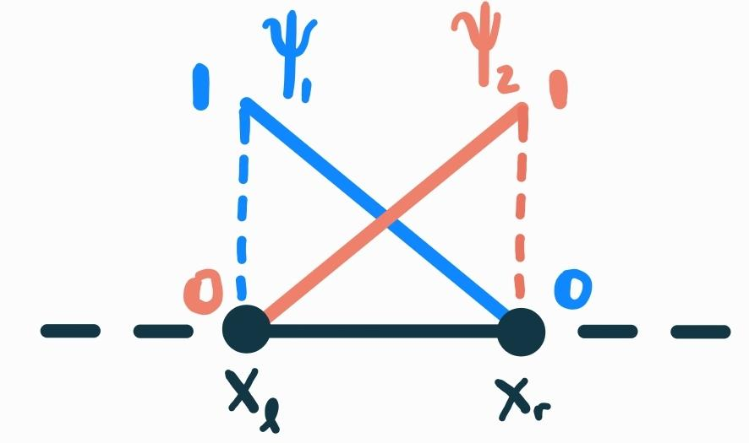
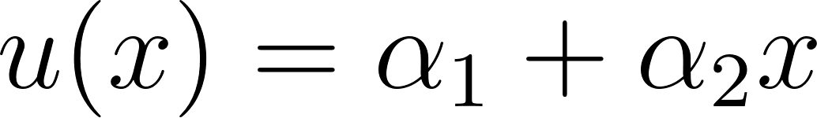
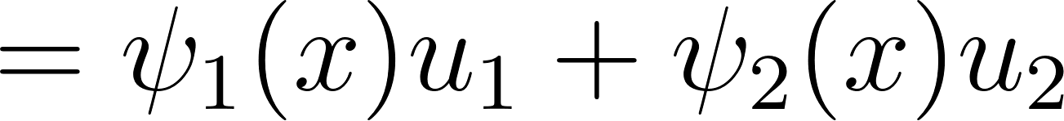
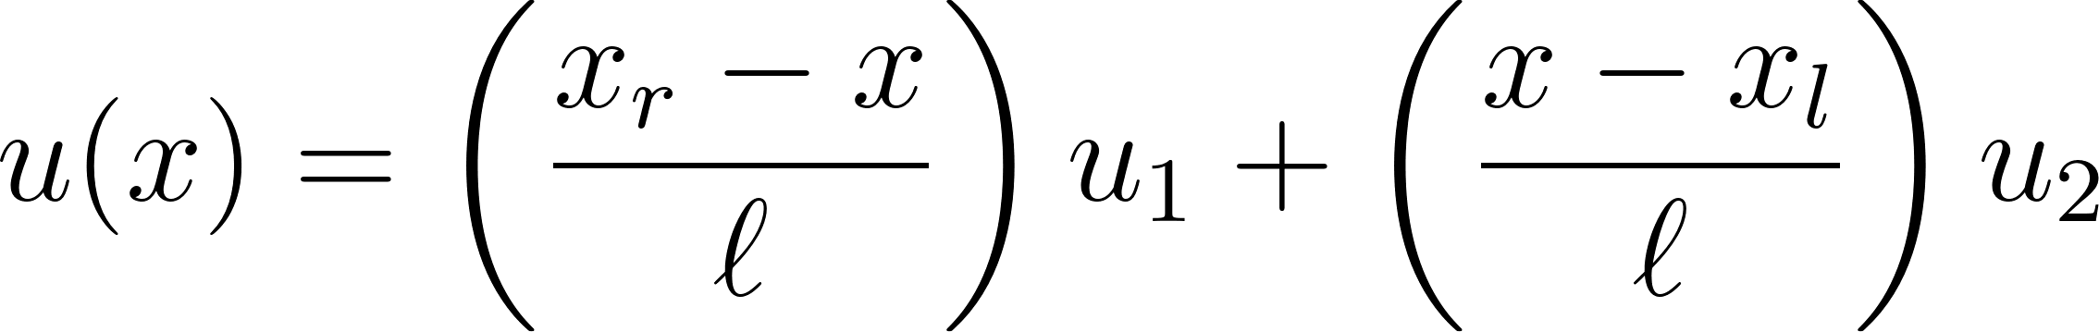
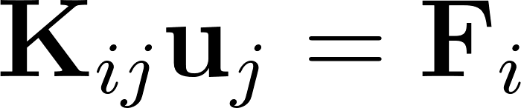
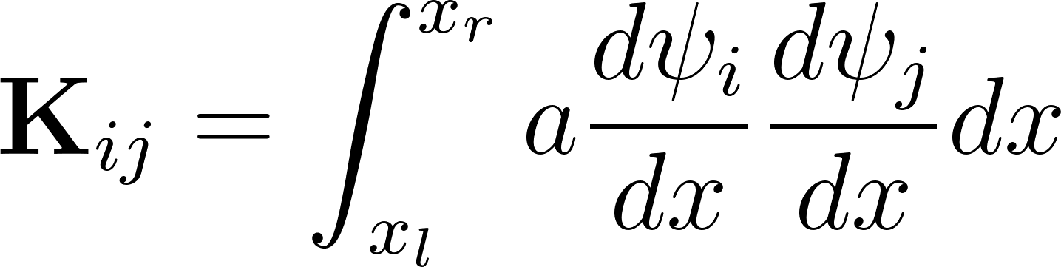
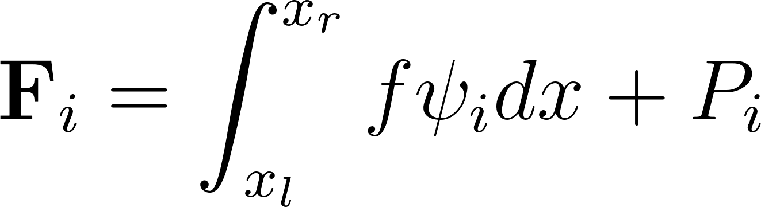
1D FEM Element Equations
FEM Formation – Basic FEM Examples – EIT Application – 3D EIT FEM – Optimization
12/6/2024
Galerkin (Weighted Residual) Method
2

Slide 7
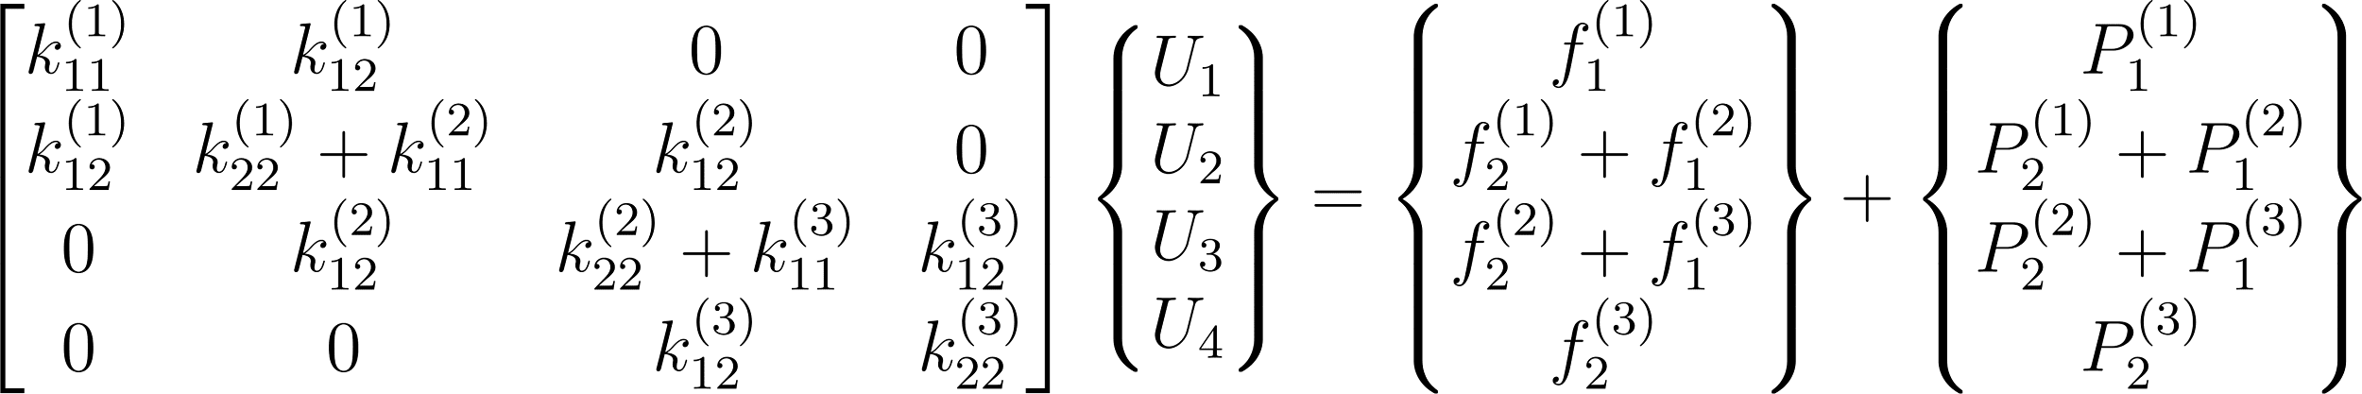
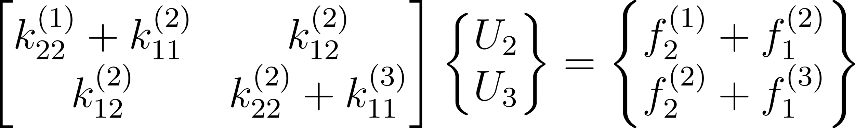
1D FEM Global Equations
FEM Formation – Basic FEM Examples – EIT Application – 3D EIT FEM – Optimization
12/6/2024
0
0
0
0
4
3

Slide 8
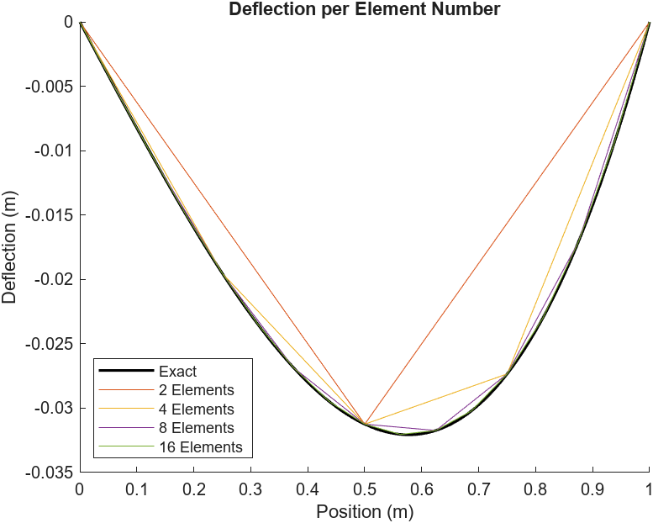
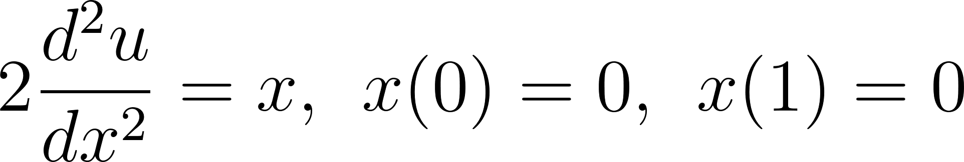
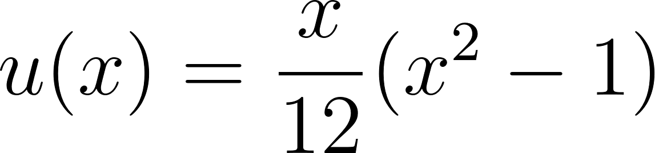
1D FEM Solution
FEM Formation – Basic FEM Examples – EIT Application – 3D EIT FEM – Optimization
12/6/2024
5

Slide 9
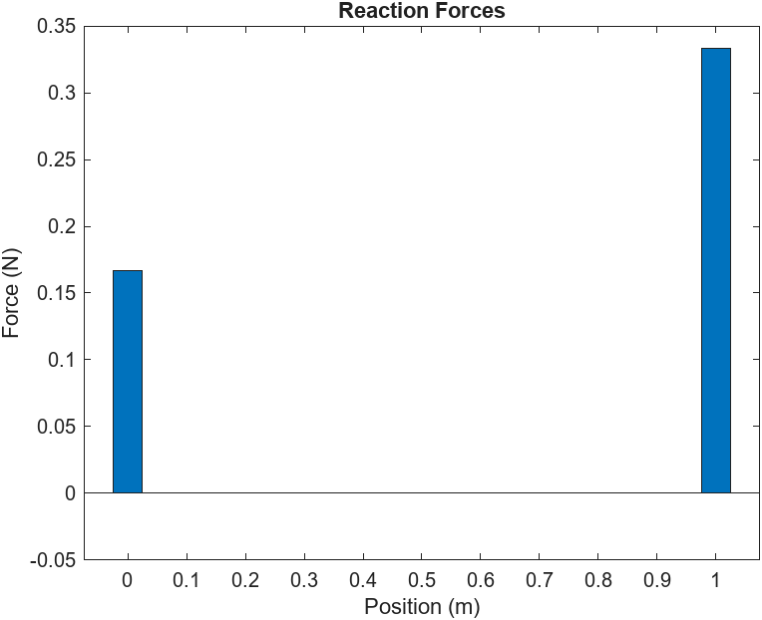
1D FEM Solution
FEM Formation – Basic FEM Examples – EIT Application – 3D EIT FEM – Optimization
12/6/2024
6

Slide 10
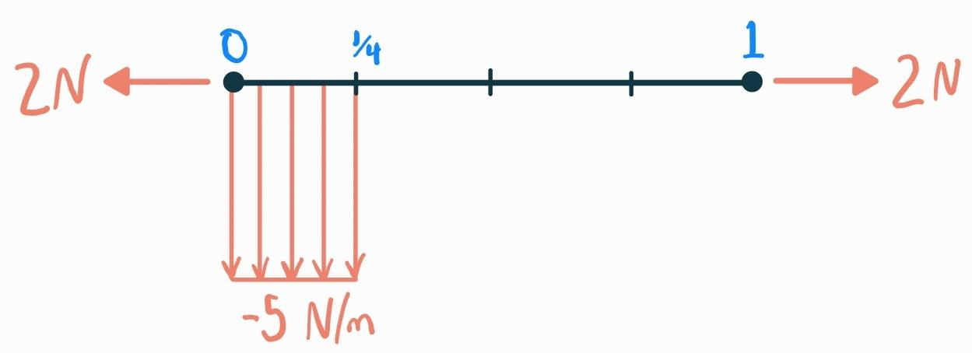
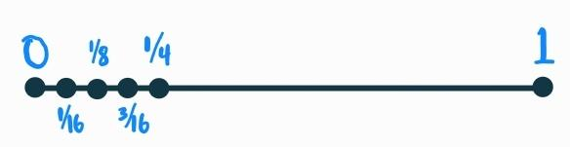

Mesh Refinement
FEM Formation – Basic FEM Examples – EIT Application – 3D EIT FEM – Optimization
12/6/2024

Slide 11
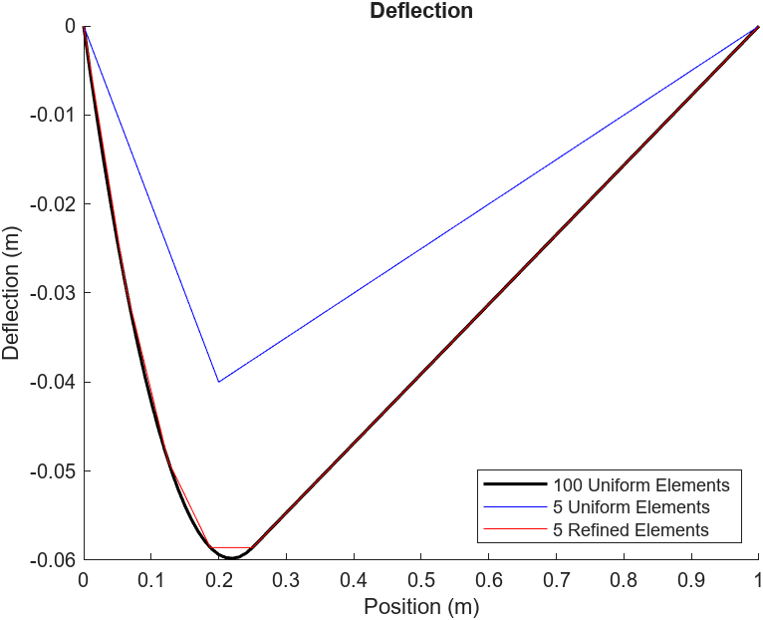
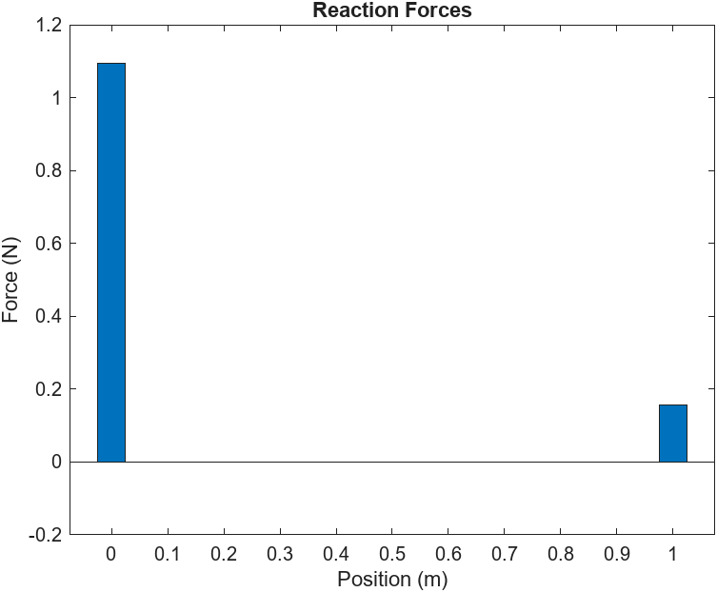
Mesh Refinement
FEM Formation – Basic FEM Examples – EIT Application – 3D EIT FEM – Optimization
12/6/2024
Notes:
5 elements: 0.15 seconds
100 elements: 2.34 seconds
15x time difference

Slide 12
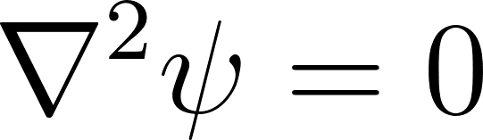
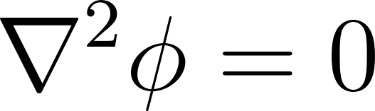
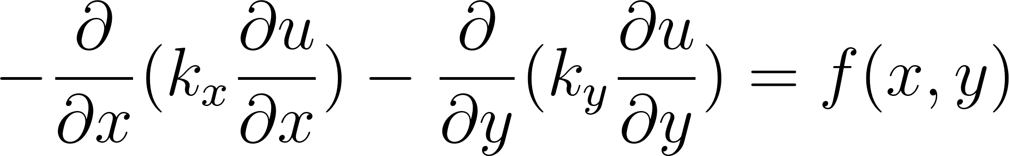
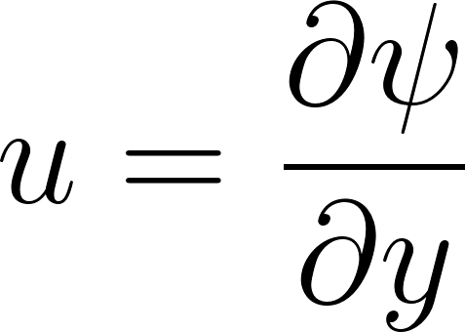
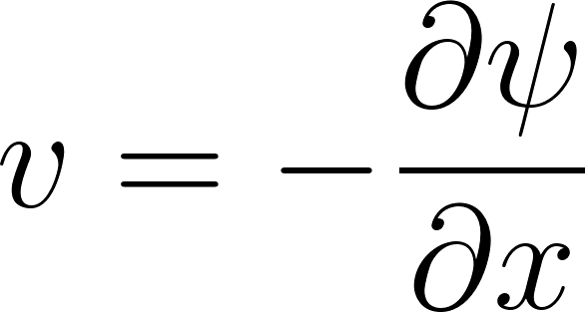
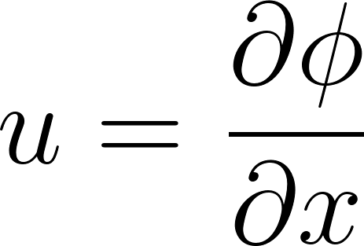
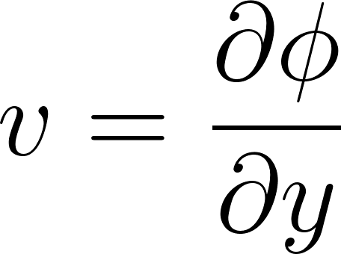
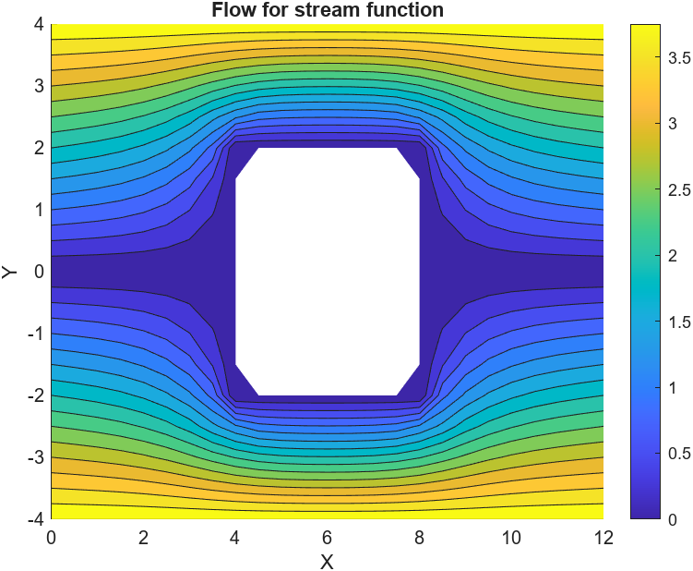
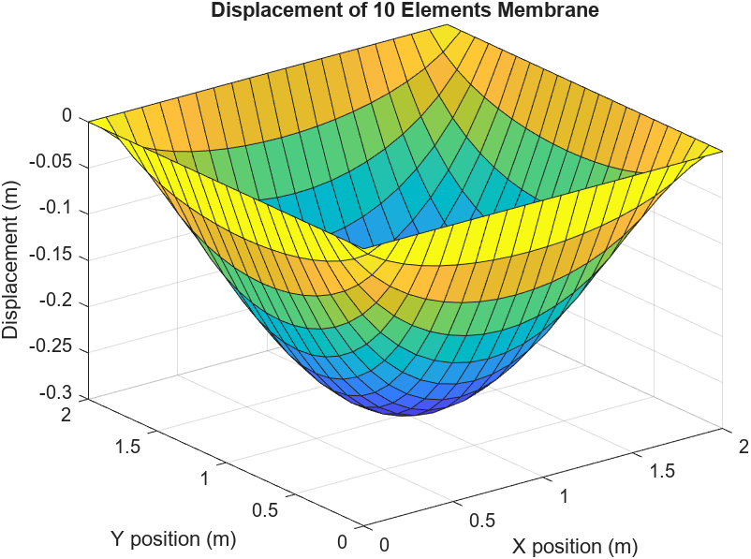
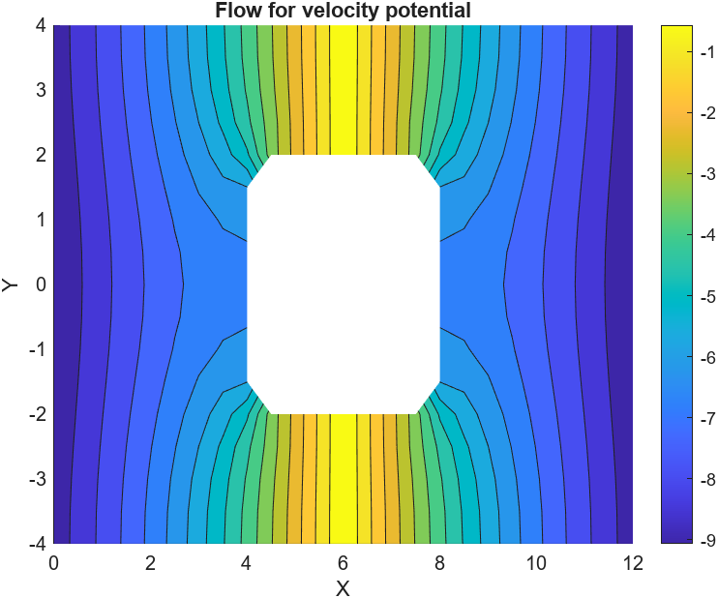
2D FEM Examples
FEM Formation – Basic FEM Examples – EIT Application – 3D EIT FEM – Optimization
12/6/2024

Slide 13
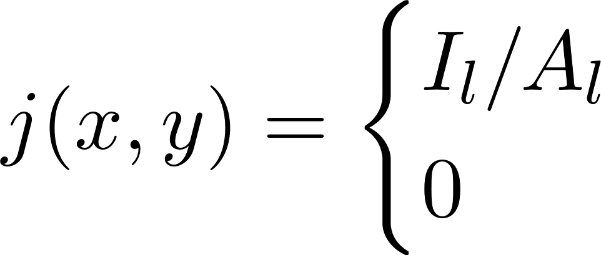
EIT Application
FEM Formation – Basic FEM Examples – EIT Application – 3D EIT FEM – Optimization
12/6/2024
on electrode l
otherwise
For inverse problem, we assume we have a mapping from the Neumann to Dirichlet boundary conditions in order to solve for 𝛔
The mapping is a matrix of Dirichlet boundary conditions from known Neumann boundary conditions
Solving for Neumann boundary like this requires knowledge of 𝛔, solving PDE

Slide 14
Meshing
FEM Formation – Basic FEM Examples – EIT Application – 3D EIT FEM – Optimization
12/6/2024
ITKSnap generate surface meshes from CT scans
Need to convert into Volumetric mesh (GMesh and Cleaver work)
General Idea: Add points in volume to create tetrahedral subdivisions
More materials and more complicated shapes require more elements to minimize error

Slide 15
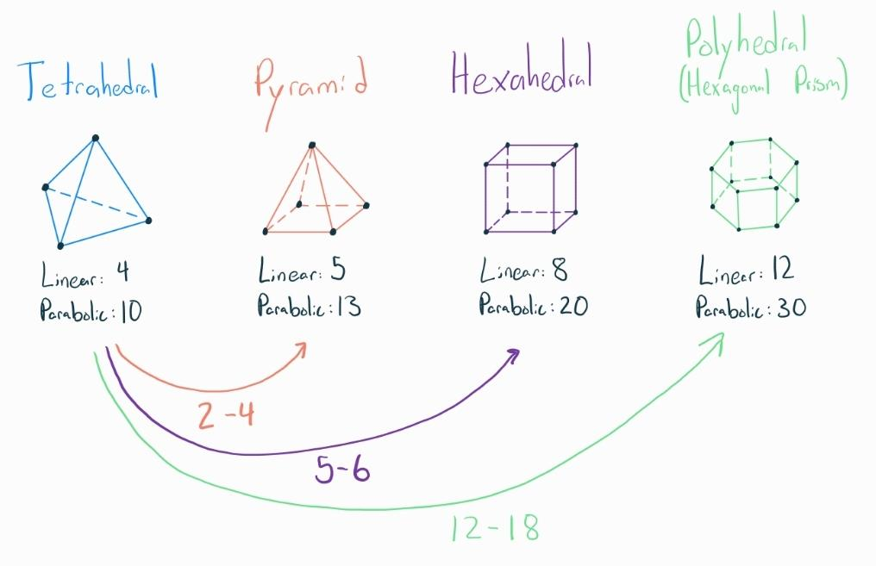
Meshing
FEM Formation – Basic FEM Examples – EIT Application – 3D EIT FEM – Optimization
12/6/2024

Slide 16
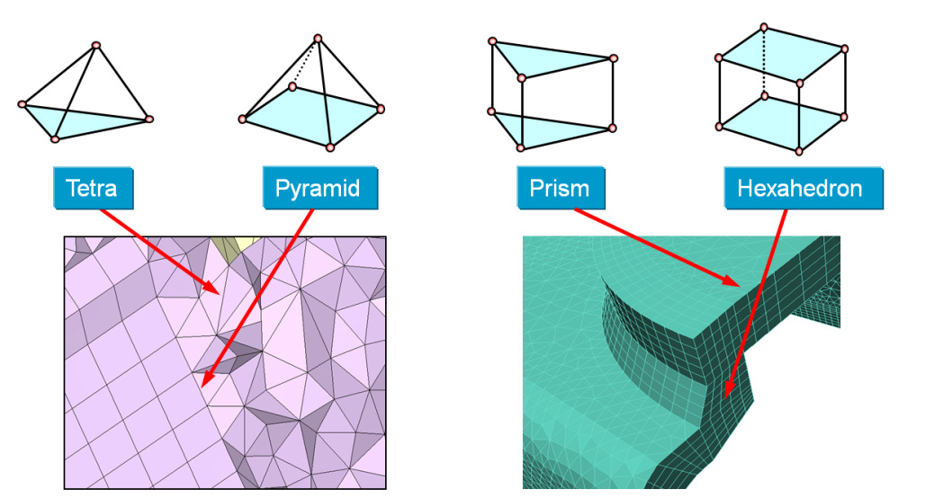
Meshing
FEM Formation – Basic FEM Examples – EIT Application – 3D EIT FEM – Optimization
12/6/2024

Slide 17
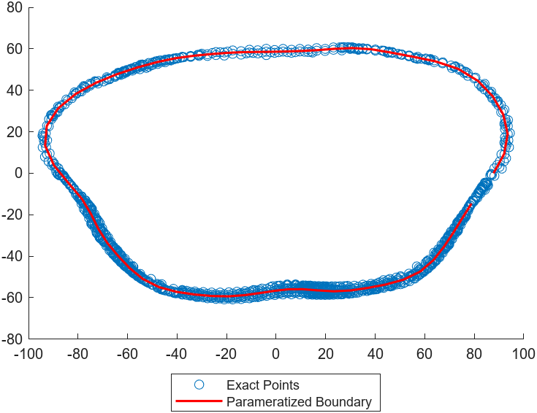
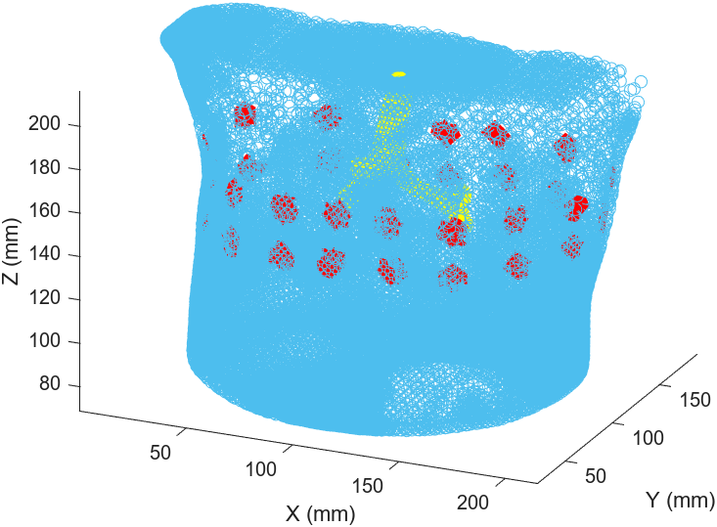
Assigning Electrodes - Belt
FEM Formation – Basic FEM Examples – EIT Application – 3D EIT FEM – Optimization
12/6/2024

Slide 18
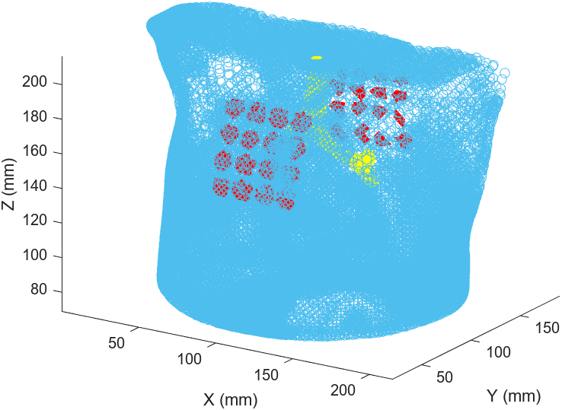
Assigning Electrodes - Patch
FEM Formation – Basic FEM Examples – EIT Application – 3D EIT FEM – Optimization
12/6/2024

Slide 19
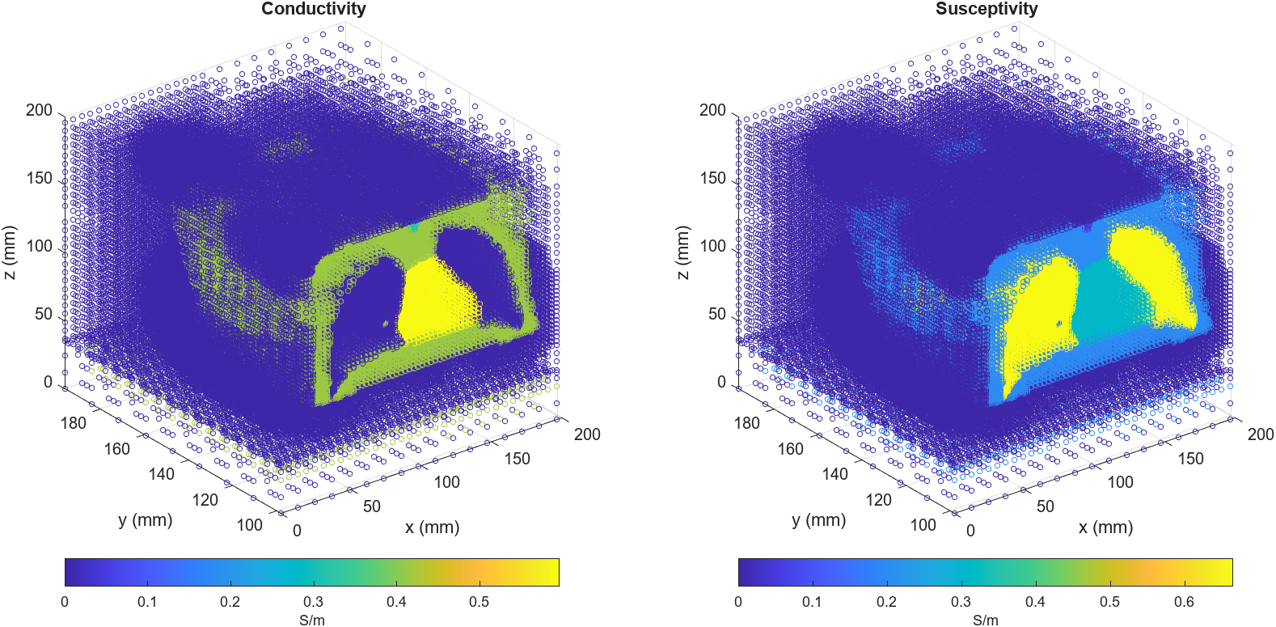
Assigning Conductivities
FEM Formation – Basic FEM Examples – EIT Application – 3D EIT FEM – Optimization
12/6/2024

Slide 20
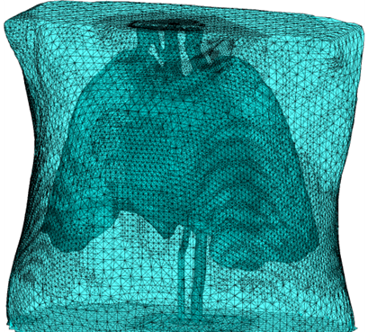
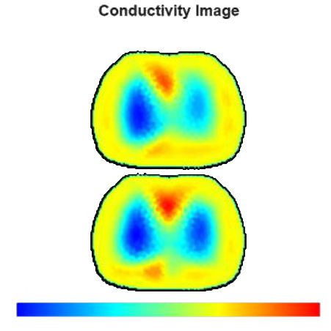
Simulated Results - OOEIT
FEM Formation – Basic FEM Examples – EIT Application – 3D EIT FEM – Optimization
12/6/2024

Slide 21
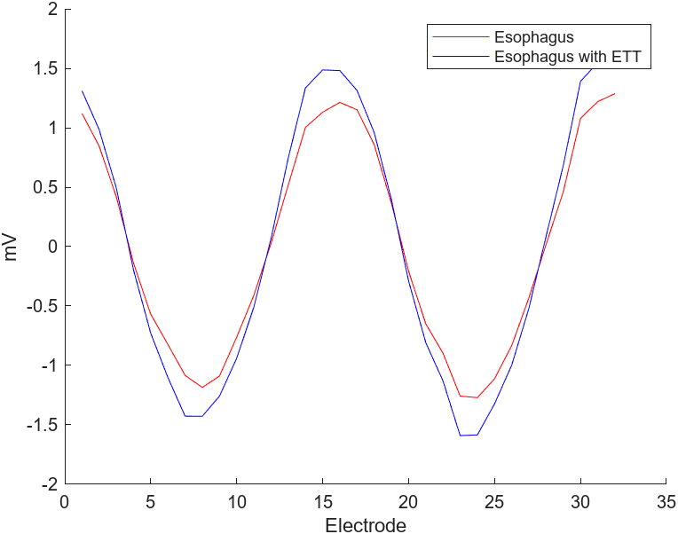
Simulated Results - OOEIT
FEM Formation – Basic FEM Examples – EIT Application – 3D EIT FEM – Optimization
12/6/2024

Slide 22
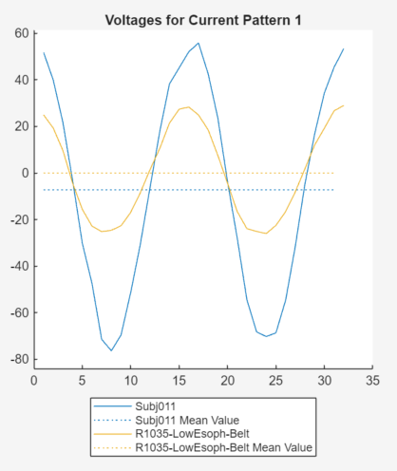
Future Work - OOEIT
FEM Formation – Basic FEM Examples – EIT Application – 3D EIT FEM – Optimization
12/6/2024
Implement distributed parallelization
Clinical comparisons
Improve electrode placement
Split lung conductivities

Slide 23
Current Progress - Deal.II
FEM Formation – Basic FEM Examples – EIT Application – 3D EIT FEM – Optimization
12/6/2024
Done
To Do
Gapless mesh generation
Fully distributed solving
Matrix-free solution generation
Split lung conductivities
Fourier Boundary parameterization for dual belt array
Extract solution from electrode centers
Clinical comparisons

Slide 24
FEM Challenges
FEM Formation – Basic FEM Examples – EIT Application – 3D EIT FEM – Optimization
12/6/2024
Size of matrix is (Number of elements * degrees of freedom * node per element)^2
We have ~6 million elements, with 6 degrees of freedom and 4 nodes per element
Solving the global equation matrix involves matrix inversion, has O(144 million ^3) operations
Takes several hours to solve one body with one set of boundary conditions, we are trying to solve hundreds of bodies with 31 boundary conditions
Cannot reduce number of elements without drastically increasing error

Slide 25
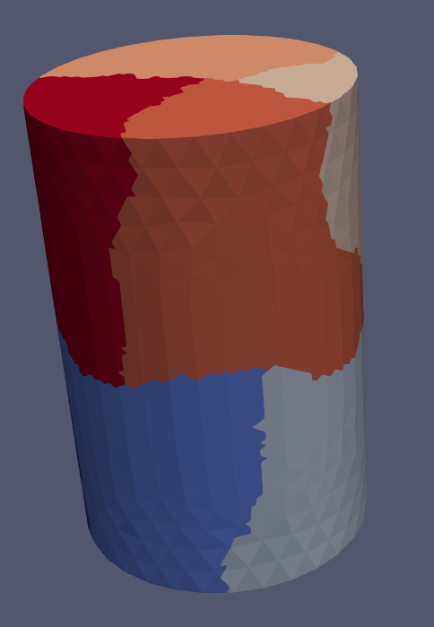
Getting Good: Parallelization
FEM Formation – Basic FEM Examples – EIT Application – 3D EIT FEM – Optimization
12/6/2024
Modern CPUs have several cores, and several threads per core. Why not use all of them?
Each core handles its own color, number of elements are equally subdivided
Solutions for each individual element require knowledge of the solutions of neighboring elements. Each CPU core only knows about elements it is responsible for
‘Ghost’ cells are implemented to let cores know about neighboring cells they don’t own, but are not ‘assigned’ to the core.
Reduces time by 1/(number of cores), so we could use GPUs to really speed things up

Slide 26
Getting Better: Matrix Free
FEM Formation – Basic FEM Examples – EIT Application – 3D EIT FEM – Optimization
12/6/2024
Turns out communicating with GPUs is very difficult, and it is slow to move data to and from the GPU
GPUs only have thousands of cores, so we would still have around (14400000^3)/1000 operations to do
We can build a linear operator that performs the group action of our matrix inverse
Construction is difficult, but number of operations for our solution becomes size of right hand side vector (14400000)
Inherent error in numerical approximation means we are constructing an approximate solution. As such, we will need to minimize error (Using CGD)
Need to construct an ‘initial’ solution, literature says to use Algebraic multigrid (Create solutions to submatrices of our original solution)

Slide 27
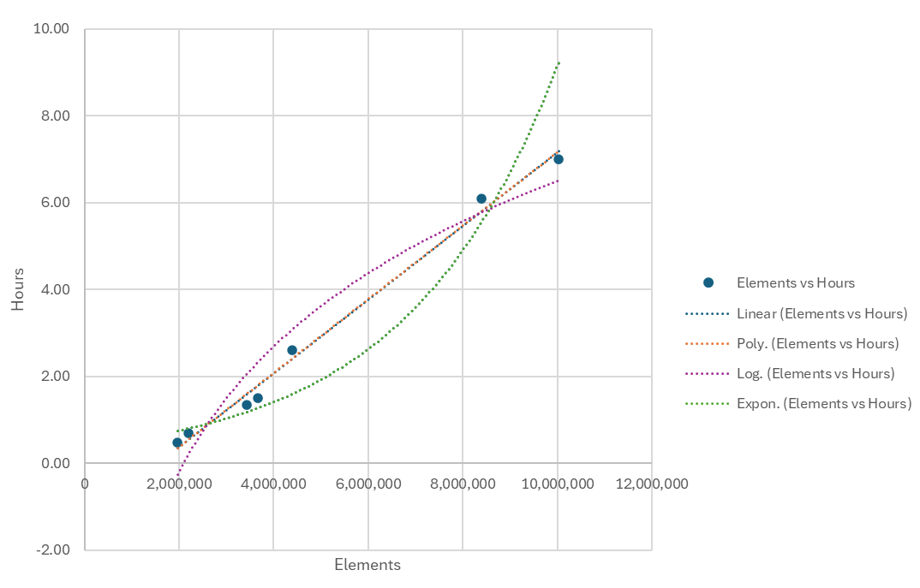
Matrix Free Run Times
FEM Formation – Basic FEM Examples – EIT Application – 3D EIT FEM – Optimization
12/6/2024

Slide 28
Becoming the Best: HP Adaptivity
FEM Formation – Basic FEM Examples – EIT Application – 3D EIT FEM – Optimization
12/6/2024
Reducing the number of elements is best way to reduce the number of necessary computations
We can merge elements not touching the external boundary without losing our body shape
We only need degree 0 polynomials (constants) for elements fully in one organ, but can fit higher degree polynomials to elements over discontinuities
With (most) meshes, this will result in lower error and lower compute time, but is a little harder to set up.
Using Fully Distributed Parallelization, HP adaptivity, and Matrix-Free methods, we have the fastest AND lowest error FEM model using current knowledge

